Slide 1
Iterative parameter calibration of hardening laws and fracture model using Bayesian multiple objective optimization
Vedant Zope
Advisors: Xuan Binh, Li Zinan, Rongfei Juan
Supervisor: Junhe Lian
Department of Mechanical Engineering
Aalto University

Slide 2

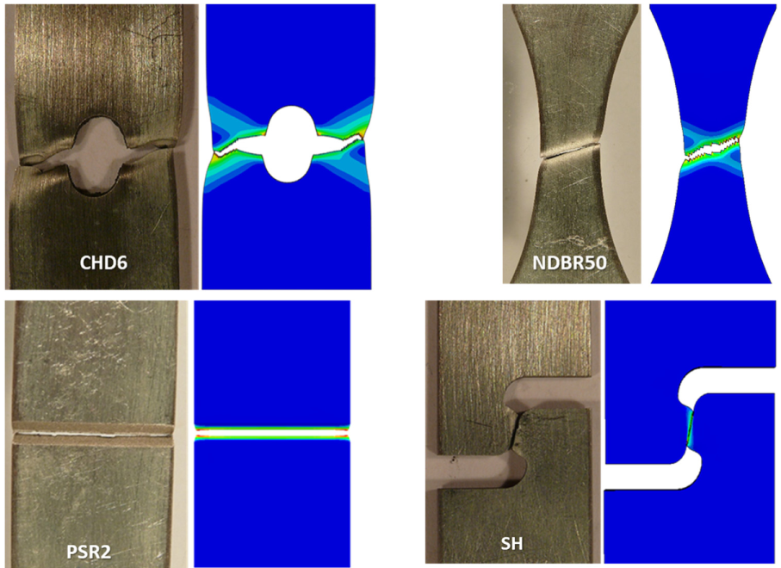
Table of contents
 | Task | Content
1 | Overview | Progress of completed tasks
2 | A5 | Problem formulation and project workflow
3 | A5 | Target FD curves and initial guesses
4 | A5 | Adaptive loss function
5 | A5 | Bayesian Multiple Objective Optimization
6 | A5 | Results of weighted single objective optimization
7 | A5 | Results of multiple objective optimization
8 | B | Problem formulation and project workflow
9 | B | eMBW model and fracture Abaqus subroutine
10 | B | Fracture simulation and postprocessing
11 | B | Effects of dynamic time step on fracture point
12 | B | Target FD curves and initial guesses
13 | B | Results of multiple objective optimization
14 | Overview | Discussions and conclusions
Image source: Prediction of crack formation in the progressive folding of square tubes during dynamic axial crushing, Wenqi Liu et al., 2020

Slide 3


Progress of completed tasks
Brief Overview of Completed Tasks
 | Task | Law | Temperature | Curve Type | Geometry | Status
A | A1 | Swift | Room | Simulated | NDBR50
 | A2 | Swift - Voce | Room | Simulated | NDBR50
 | A3 | Swift - Voce | Room | Experimental | NDBR50
 | A4 | Swift – Voce | 400 C | Experimental | NDBR50
 | A5 | Swift - Voce | Room | Experimental | NDBR50, NDBR6, CHD6
B |  | Fracture eMBW model | Room | Experimental | NDBR50, NDBR6, CHD6
C |  | Hydrogen Dependency
Detailed Overview towards the end of the presentation

Slide 4
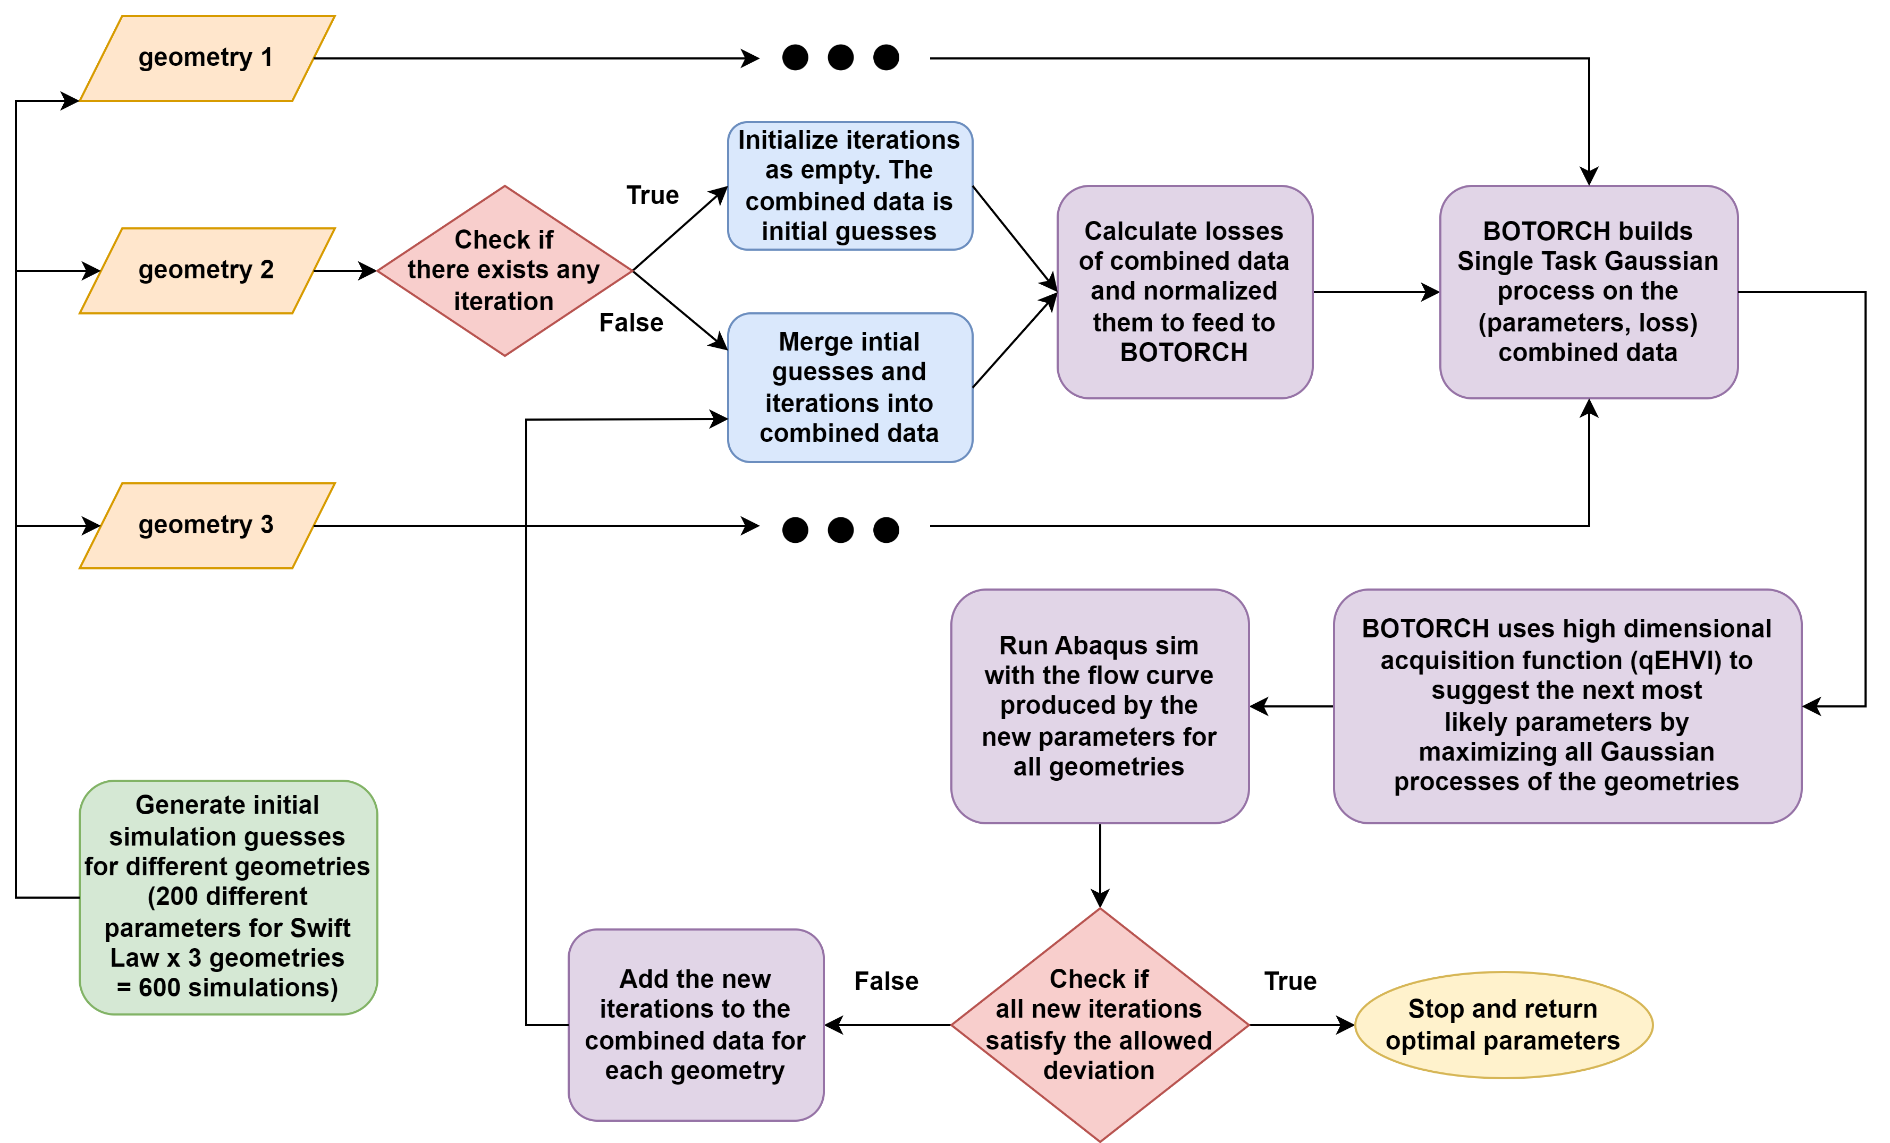
Task A5: Problem formulation and project workflow
Background:
Tasks A1-A4 established a method to:
Input: Single F-D curve
Output: Swift Voce parameters to generate a flow curve.
Objective: The simulated flow curve should align with the experimental FD-curve.
Task A5 Challenge:
How can we extend the established method to:
Input: Multiple F-D curves
Output: Swift Voce parameters to generate ONE SINGLE flow curve
Objective: The single flow curve should match all the experimental FD-curves simultaneously.

Slide 5
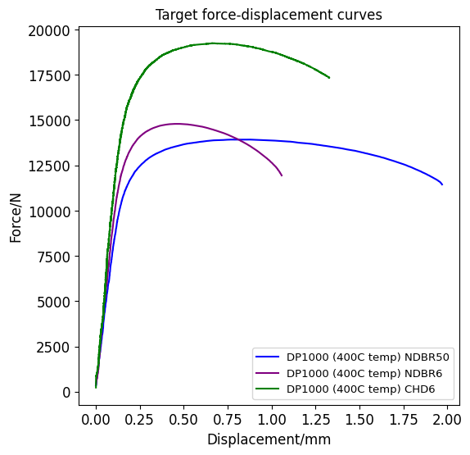
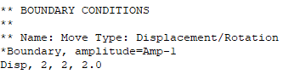
Task A5: Target FD curves
Target curves of different geometries have different displacement range
Displacement Difference
Problem: How to align diverse displacement values?
Task A5: Replace maximum displacement for each geometry into their respective material.inp files
Fracture Correspondence
Problem: Arbitrary displacement values can halt the FD curve(Maximum Tensile Displacement) but does not signal fracture points.
Insight: Fracture models predict these exact points.
NDBR50 | NDBR6 | CHD6
0 - 2mm | 0 - 1.3mm | 0 - 1.1mm
Task B: Find the ductile fracture parameters such that simulations result in exact location of fracture points

Slide 6
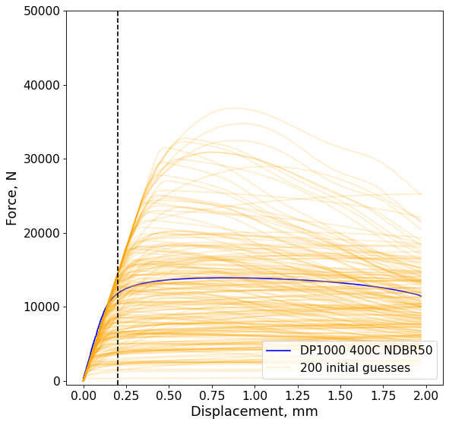
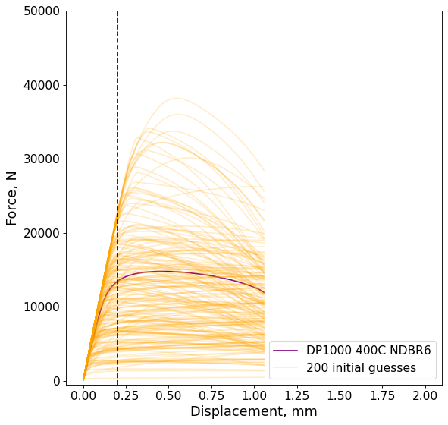
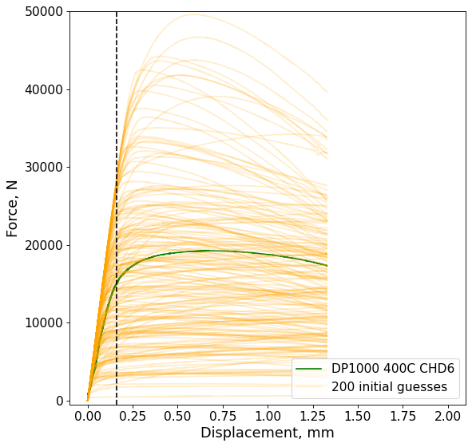
Task A5: Initial guesses
NDBR50
NDBR6
CHD6
Issue | Causes | Proposed Solution
Slope of elastic region by FEA does not match that of the elastic region of experimental data | Varying Experimental conditions External factors: Ambient temperature fluctuations Variability among metal manufacturers | Compare only the plastic region starting from the dotted horizontal line with respect to each curve The loss and stop condition also consider only plastic region and ignore elastic region

Slide 7
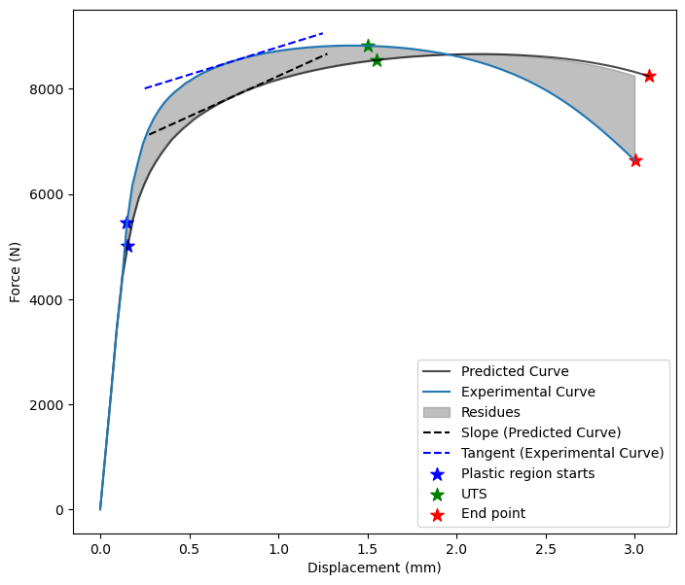

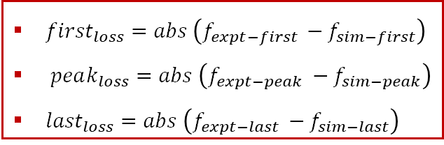
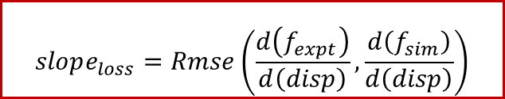
Adaptive Loss Function
Step 1: Macro Fitting
In the initial phase, the loss function focuses on the curve's general shape using residuals and slope for a broad fit.
$$res_{loss}=Rmse \left(f_{expt},f_{sim}\right)$$
$$slope_{loss}=Rmse\left(\frac{d\left(f_{expt}\right)}{d\left(disp\right)},\frac{d\left(f_{sim}\right)}{d\left(disp\right)}\right)$$
Step 2: Micro Fitting
After capturing the curve's primary characteristics, the calibration refines specific points. As iterations advance, the importance of initial, peak, and final points grows, ensuring precise model alignment.
${first}_{loss}=abs \left(f_{expt−first }−f_{sim−first}\right)$
$peak_{loss}=abs \left(f_{expt−peak }−f_{sim−peak}\right)$
${last}_{loss}=abs \left(f_{expt−last }−f_{sim−last}\right)$
w_first = iteration * 0.001
w_peak = iteration * 0.001
w_last = iteration * 0.001
Finally, Losses are normalized before weighting, ensuring robustness across various curve scales, and eliminating the need for weights recalibration when target curves changes. (improvement over previous loss function)

Slide 8
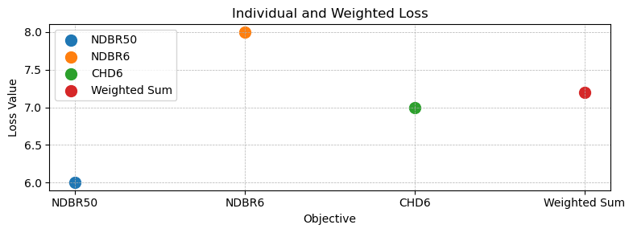



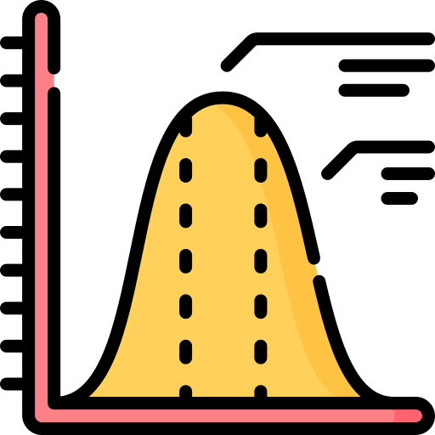



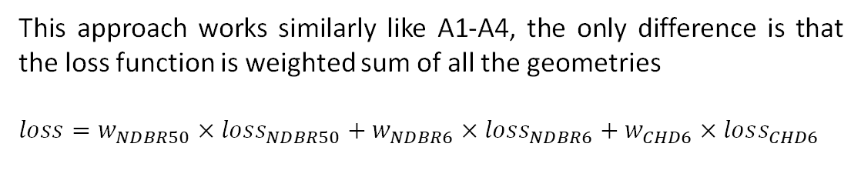
Task A5 : Bayesian Multiple Objective Optimization
Approach 1
Weighted Bayesian Optimization
This approach works similarly like A1-A4, the only difference is that the loss function is weighted sum of all the geometries
$$loss=w_{NDBR50}×loss_{NDBR50}+w_{NDBR6}×loss_{NDBR6}+w_{CHD6}×loss_{CHD6}$$
Approach 2
 | Features | Description
1 | Parameter Flexibility | Works with Arbitrary number of Parameters
2 | Objective Versatility | Adapts to multiple objective functions
3 | Data Utilization | Efficiently utilizes initial guesses for creating surrogate models(gaussian process)
4 | Streamlined Optimization | Does not need to continuously evaluate the loss function
5 | Results | Returns a comprehensive set of top-performing solutions(Pareto Front)

Slide 9
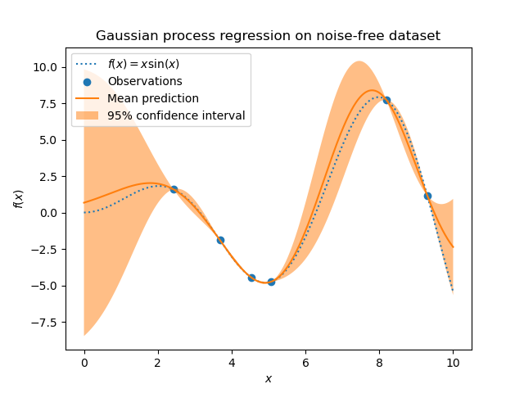
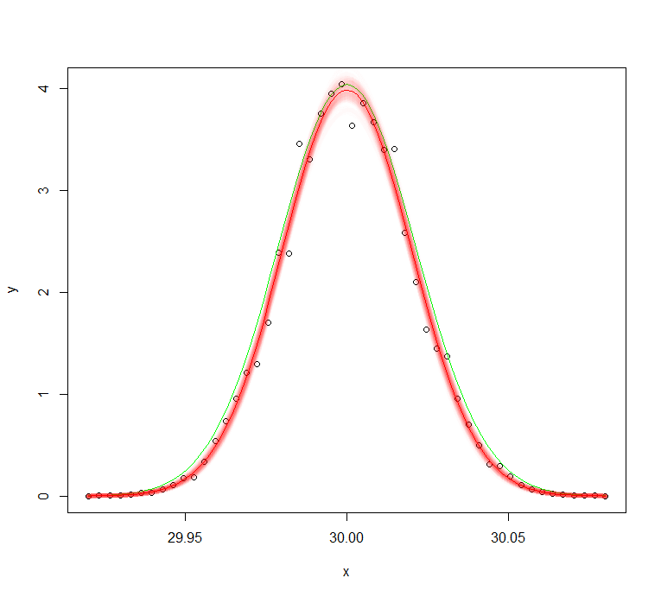
Task A5 : Bayesian Multiple Objective Optimization(BoTorch)
Single Task GP
qEHVI Acquisition Function
A Gaussian Process (GP) tailored for modeling a single task or output, which is individually modelled for each geometry
Assumes a homoscedastic noise level (constant noise variance across input space).
Multi-Objective: Can Optimize Multiple conflicting objectives.
Pareto Improvement: Boosts hypervolume of the Pareto front.
Efficiency: Traverses the design space effectively.
Adaptable: Accommodates diverse constraints.
Parallel Use: Exploits parallel hardware aggressively
Likelihood Maximization
Normalization & Standardization
Purpose: Refine model parameters to best fit data.
Process: Maximizes the probability of observed data given the parameters.
Role in GP: Critical for defining the model's fit to the data
Bounds Setting: Define upper and lower bounds for guidance.
Normalization: Scale parameters to [0, 1] for consistency.
Standardization: Adjust outputs to zero mean and unit variance.
Post-Optimization: Inverse transform candidates for actionable results.

Slide 10
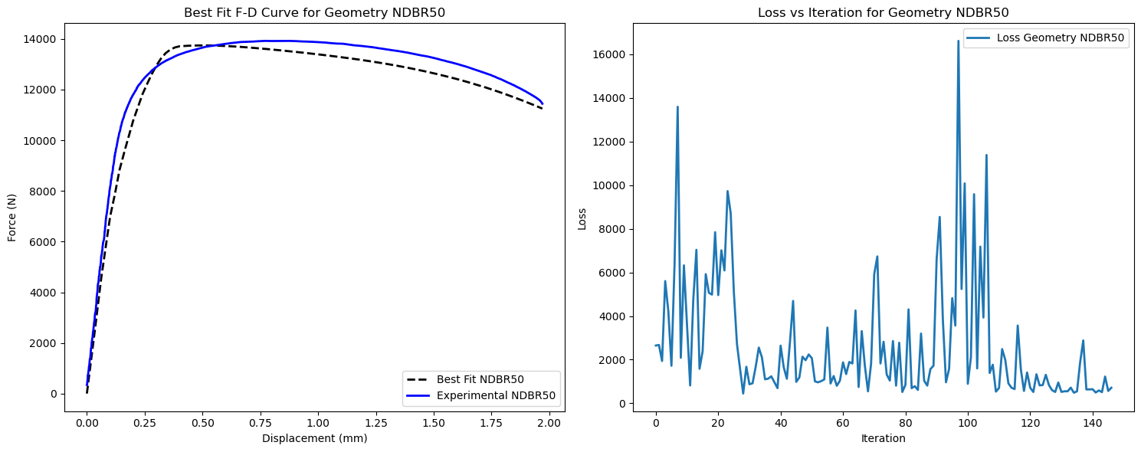
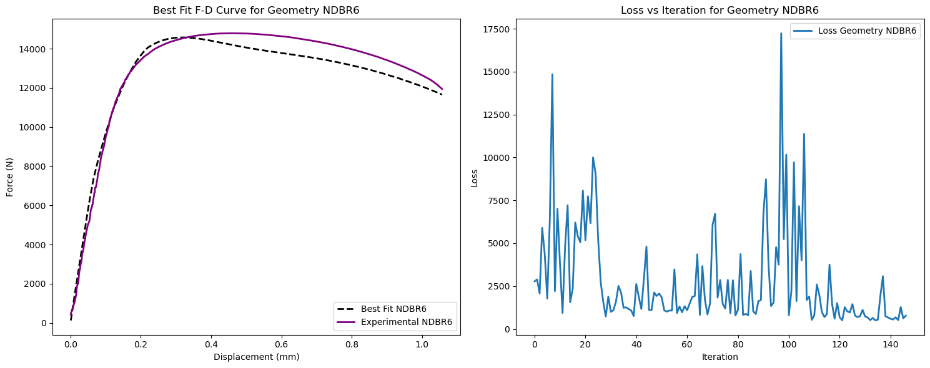
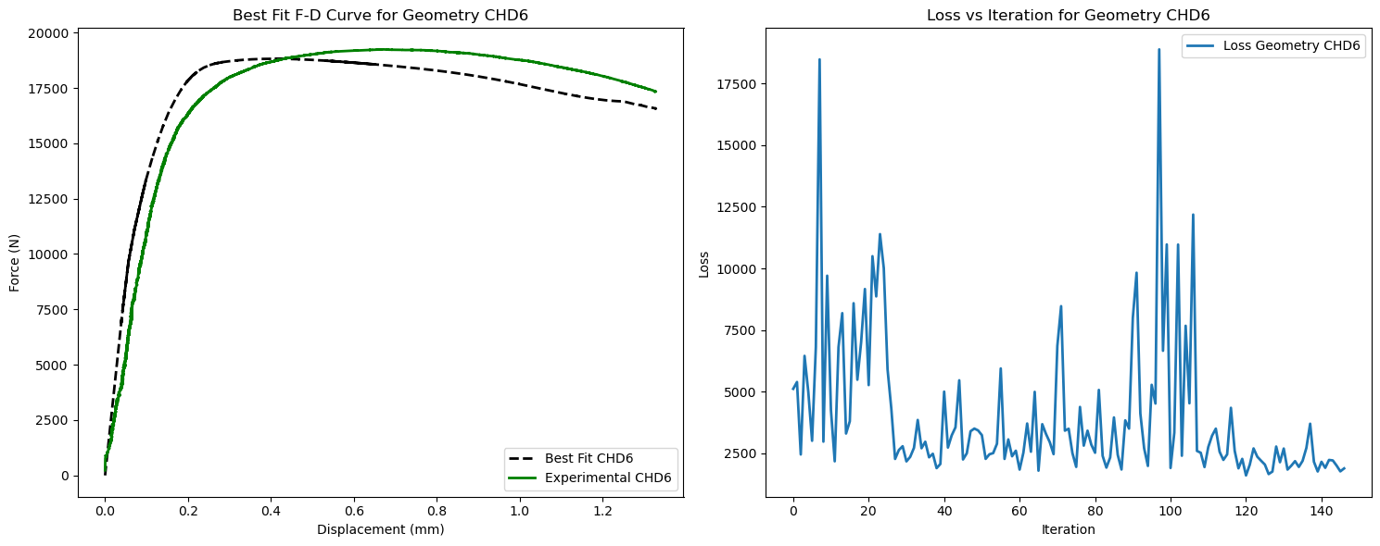
Task A5: Results of weighted Multi objective optimization
Swift Voce | Value
W | 0.478
K | 768.59
ε₀ | 0.0557
n | 0.507
σᵧ | 610.079
σₛₐₜ | 935.86
β | 420.58

Slide 11
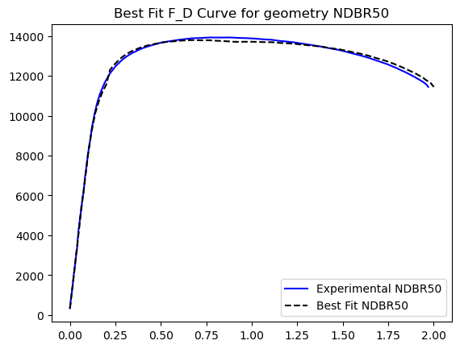
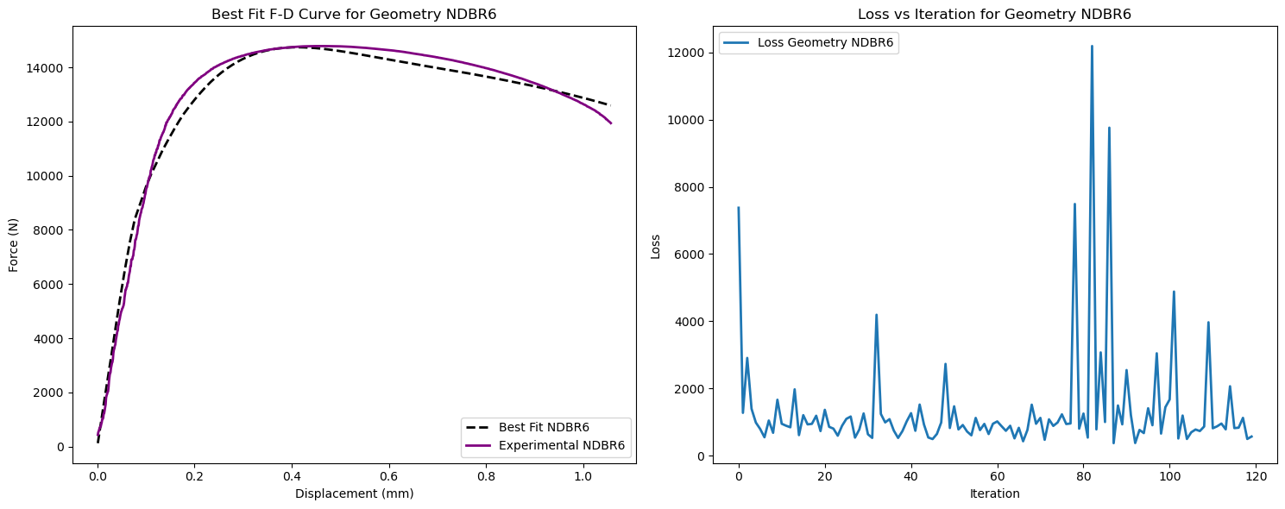
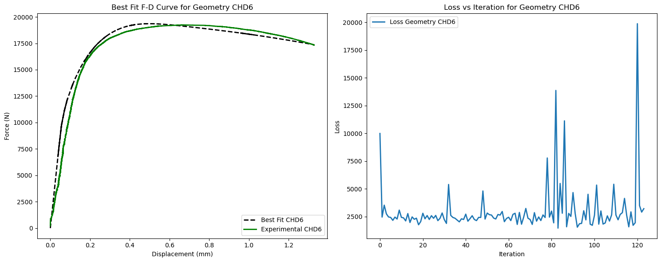
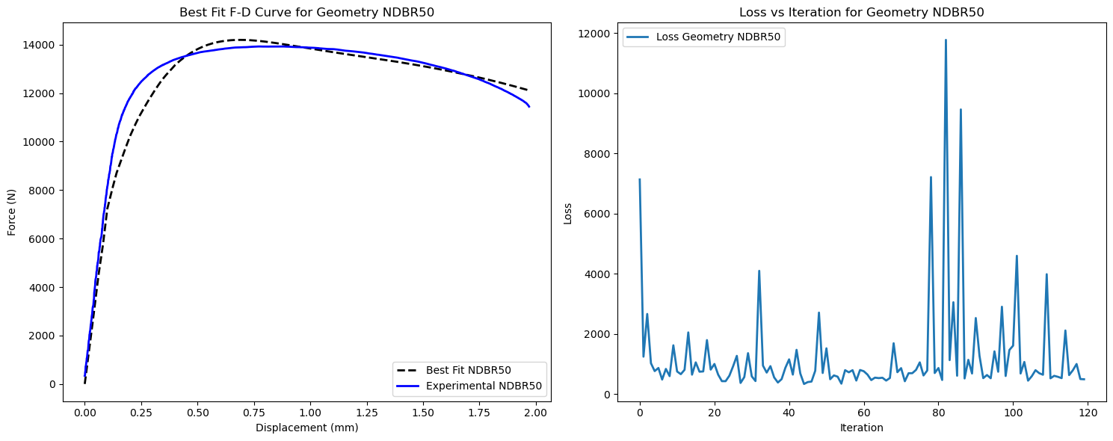
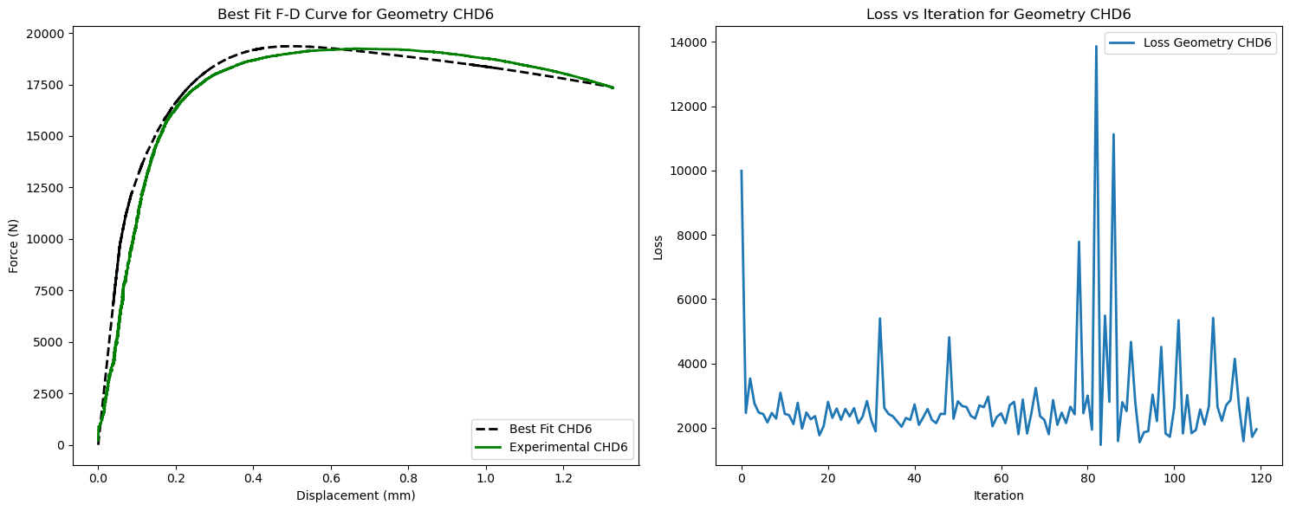
Task A5: Results of multiple objective optimization(BoTorch)
Swift Voce | Value
W | 0.501
K | 754.364
ε₀ | 0.02957
n | 0.987
σᵧ | 901.263
σₛₐₜ | 944.908
β | 176.559

Slide 12
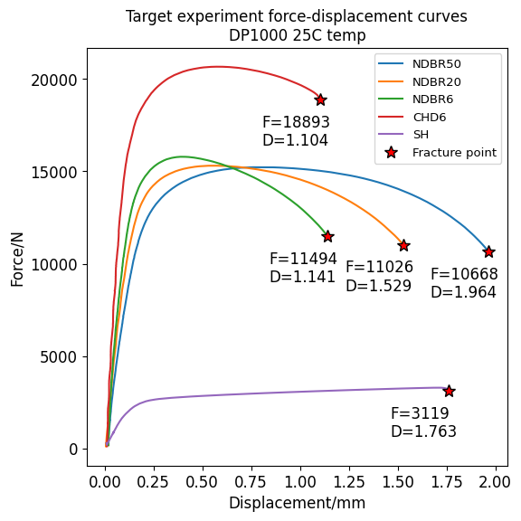
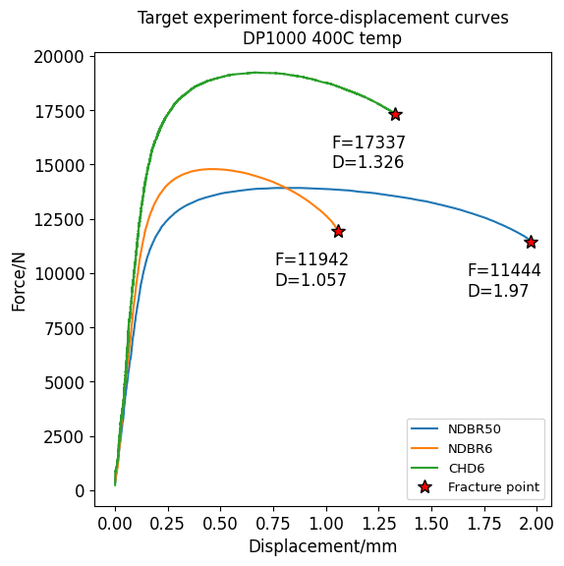
Task B: Target FD curves

Slide 13
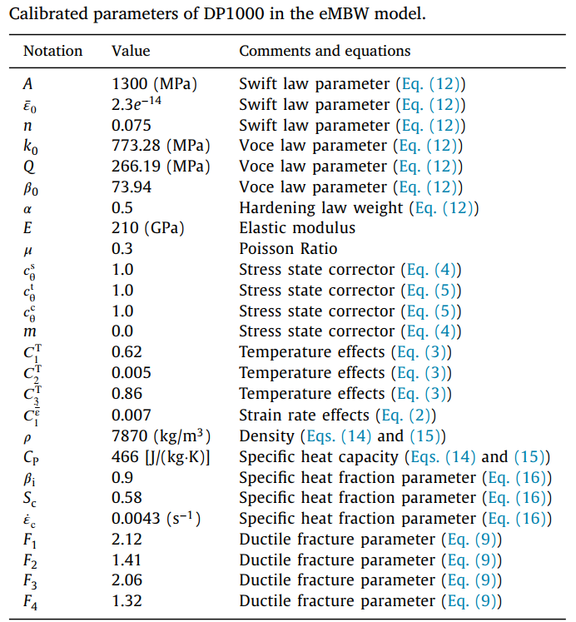
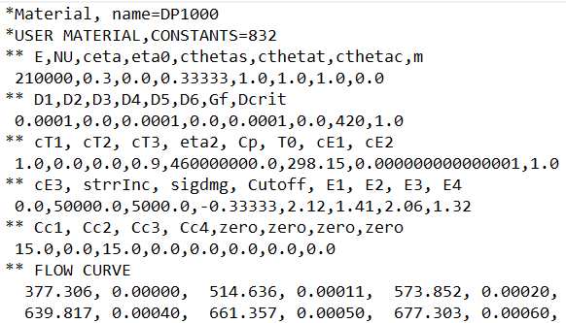

Task B: eMBW model and fracture Abaqus subroutine
Extended modified Bai-Wierzbicki (eMBW) model
Abaqus fracture user subroutine
User subroutine VUMAT is used to define the mechanical constitutive behavior of the material
Use VUMAT when none of the existing ABAQUS/Explicit models accurately represents the behavior of the material
Fracture simulation requires the Intel OneMPI Fortran compiler (ifort, Intel Classic) + a Fortran subroutine file
The Abaqus version is 2018. The 2022 version do not accurately delete elements in fracture simulation on CSC
Optimized flow curve (400C) from Task A5 will be replaced here. This optimized flow curve is for room tempereture
Source: Prediction of crack formation in the progressive folding of square tubes during dynamic axial crushing, Wenqi Liu et al., 2020

Slide 14
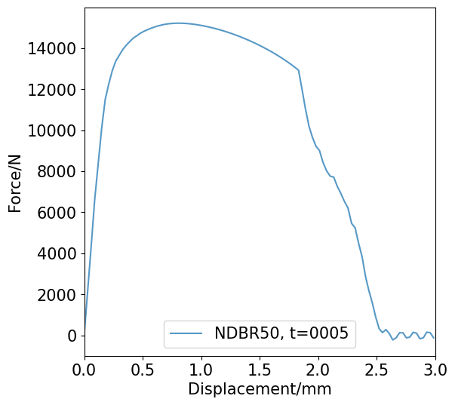
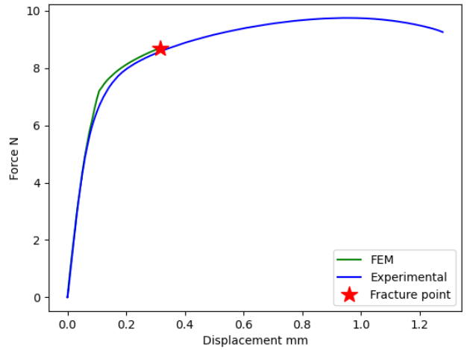
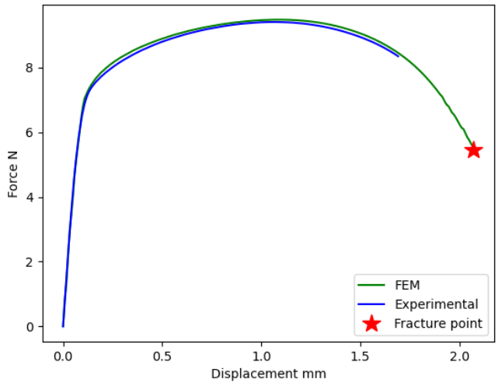
Task B: Fracture simulation and postprocessing
Fracture point is taken as the point with sudden drop in the FD curve. This postprocessing uses extrapolation method with next prediction error larger than 5% as the fracture point index
NDBR50
NDBR20
NDBR6
Fracture point lies on the shape of FEM simulated FD curve => Fracture point is independent of the flow curve and depends on the fracture parameters only
CHD6
SH
Some FEM sims do not result in complete fracture:
Reason: nonoptimal
flow curve or imprecise ductile
fracture parameters

Slide 15
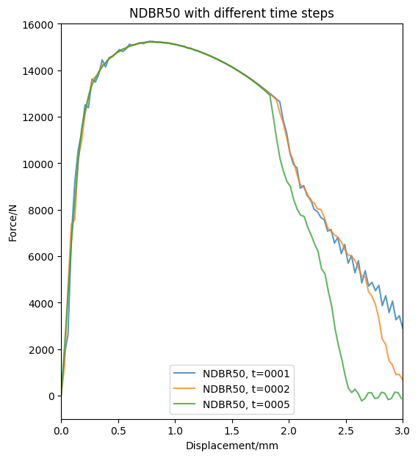
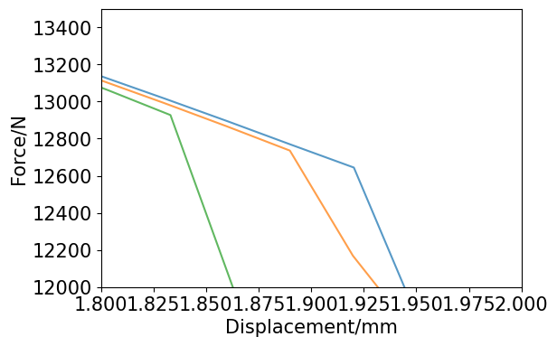
Task B: Effects of dynamic time step on fracture point
Abaqus step is a distinct phase of the loading history
An increment is part of a step
The selected increments written to the ODB file are frames
if we apply a load in 100 solution steps for a time period of 0.5s, then the time step size is 0.005s
 | Large Step Size | Small Step Sizes
Advantage | Smooth FD Curve Precise fracture point | Fast simulation time
Dis Advantage | Lengthy simulation time | Jagged FD Curve Imprecise fracture point
t=0.005
t=0.002
t=0.001
To strike a balance between accuracy and computational time, we choose 0.002 as the time period

Slide 16
Task B: Target FD curves

Slide 17
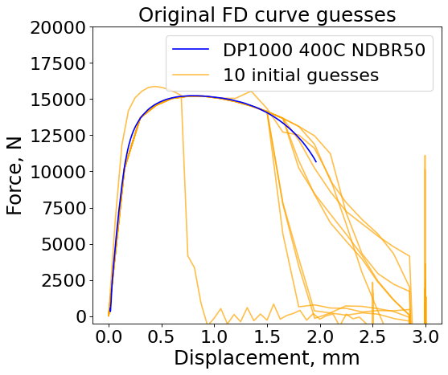
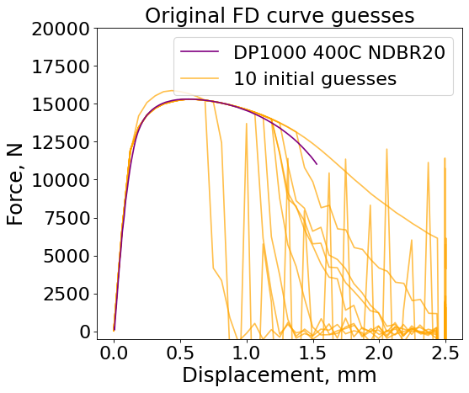
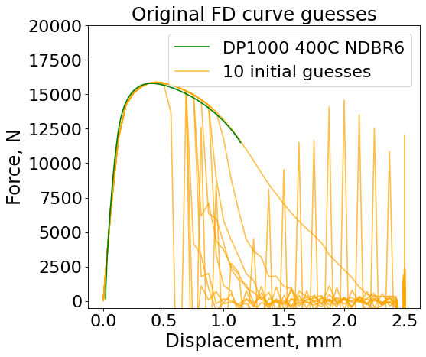
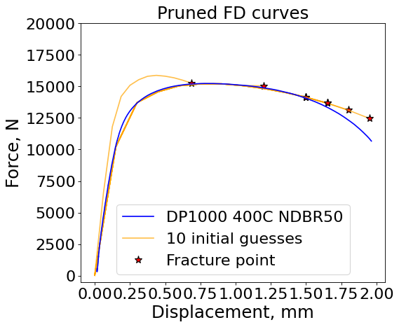
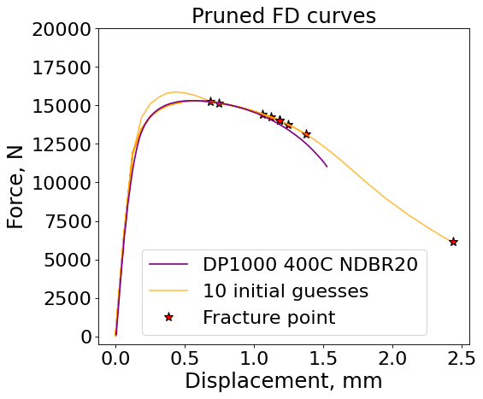
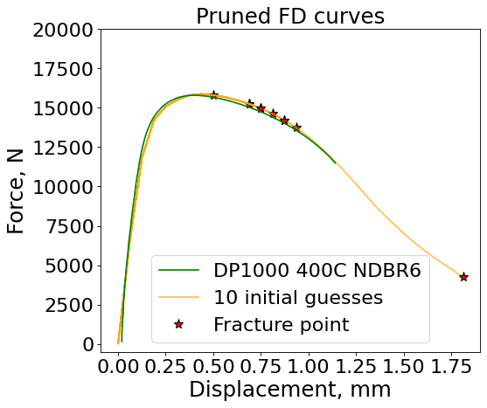
Task B: Initial guesses

Slide 18
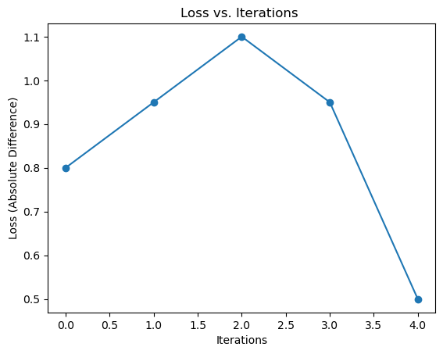
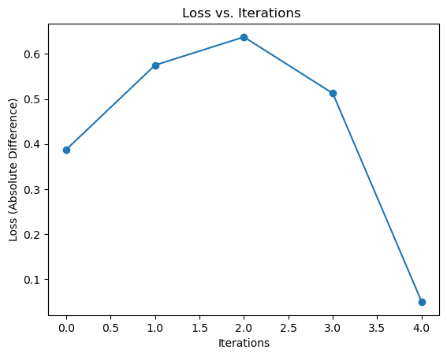
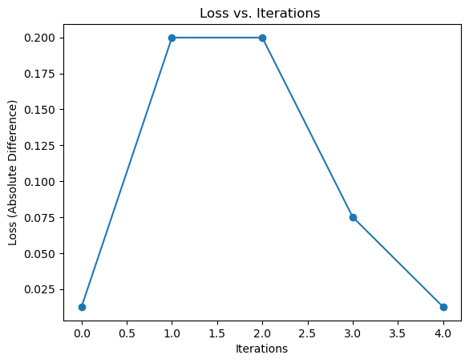
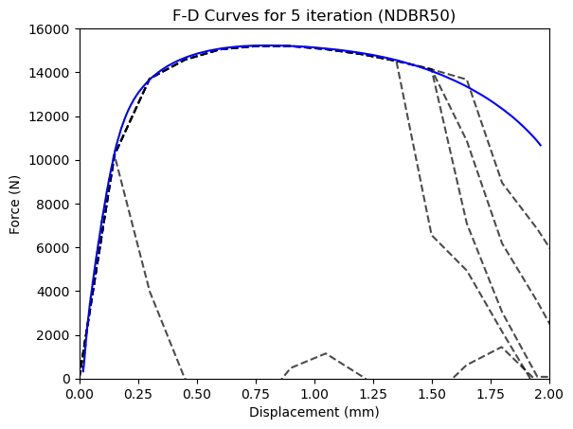
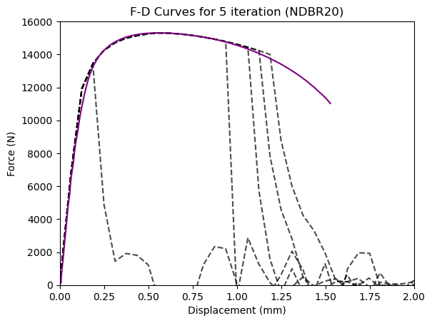
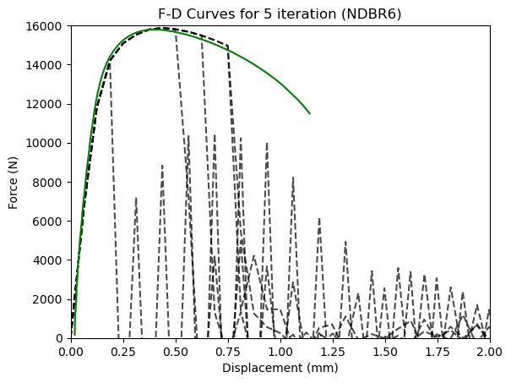
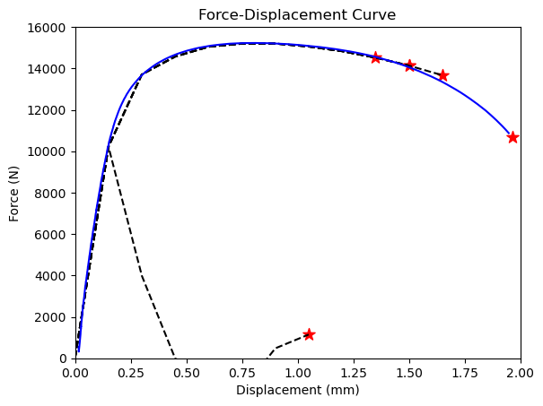
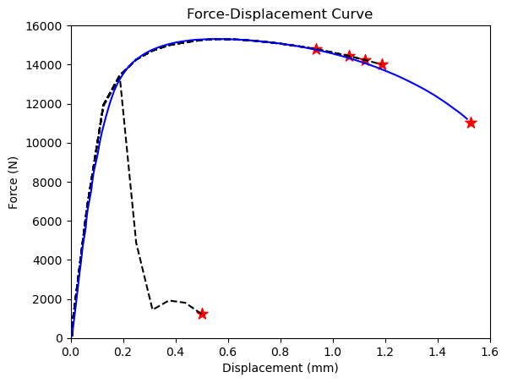
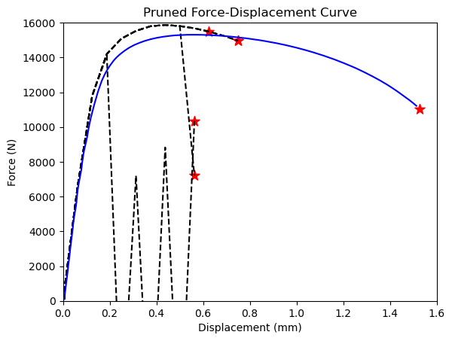
Task B: Results of multiple objective optimization
Loss = abs(exp_disp – sim_disp)
Fracture params | Predicted Value
F1 | 0
F2 | 0.934
F3 | 0.696
F4 | 2.724

Slide 19
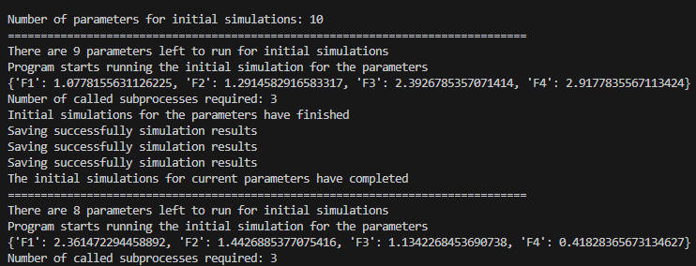
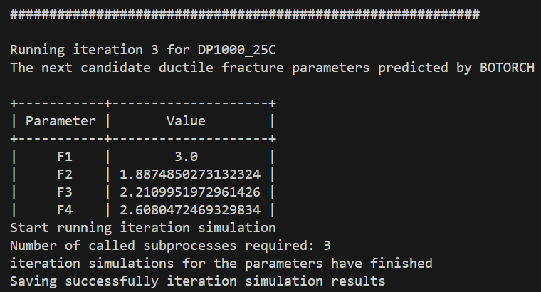
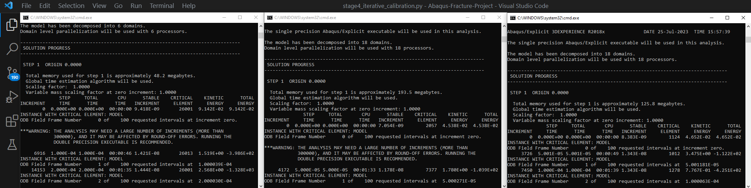
Task B: Demonstrations of the running code
Running initial simulations sequentially instead of parallel like CSC
Next set of parameters predicted by BOTORCH
For each iteration, N-geometries subprocesses are called for Abaqus fracture simulation for each geometry
NDBR50
NDBR20
NDBR6

Slide 20
Discussions
Task A5 difficulties:
Slope Mismatch: The experimental and simulated curves slope did not align. Therefore, we focused on aligning just the plastic region. However, distinguishing between the elastic and plastic regions of the force-displacement curve is challenging therefore currently it is done manually, with the yielding index input for each geometry in the GlobalConfig.
Bayesian Optimization Limitations: The weighted Bayesian optimization, when employed for Multi-Objective Optimization (MOO), yielded subpar results. Its structure, primarily designed for single-objective optimization, seems to be a limiting factor.
Task B difficulties:
Simulation Duration: The simulation is extremely time-consuming, even with a time step of 0.002, Specifically:
CHD6 and SH: Approximately 5 hours
NDBR50, NDBR20, and NDBR6: Roughly 2 hours 20 minutes
(Tested on Intel Core™ i9-9980XE CPU)
Curve Irregularities: The time step yields jagged curves, complicating the automated determination of the fracture index and often necessitating manual oversight.
Data Granularity: With a frequency of 100 points, the data is not granular enough to pinpoint precise fracture points. Consequently, many simulations present identical fracture coordinates despite variations in fracture parameters.

Slide 21
Conclusions
 | Task | Workflow Setup | Preliminary Results | Fine-tuned Results | Future Work needed
A | A1 | Properly Setup and Tested |  |  | --
 | A2 A3 A4 A5 | Properly Setup and Tested |  |  | Slight Fine Tuning the model is needed to get almost perfectly accurate results
B |  | Properly Setup and Tested |  |  | Figure out how to run Task B on CSC or Fine Tune the model to make it work efficiently and accurately on Local Setup model more accurate ways to determine fracture point
C |  | Not Setup |  |  | Properly setup the workflow obtain the preliminary results finetune the model
Task B can be more efficiently addressed if fracture simulations could be run on CSC, as relying solely on a local machine to run the simulations sequentially, prolongs the process considerably.

Slide 22

Special Thanks
I extend my deepest gratitude to Professor Junhe Lian for granting me this invaluable opportunity. This summer has been a transformative journey, both academically and culturally. The learnings and experiences have truly enriched my perspective.
I would also like to extend my heartfelt thanks to my advisors, Mr. Binh, Ms. Rongfei, and Ms. Zinan. Their unwavering support, guidance, and mentorship have been instrumental throughout this endeavor.

